Slide 1
NCMRWF Status Update – GODEX-2
V.S. Prasad
vsprasad@ncmrwf.gov.in

Slide 2
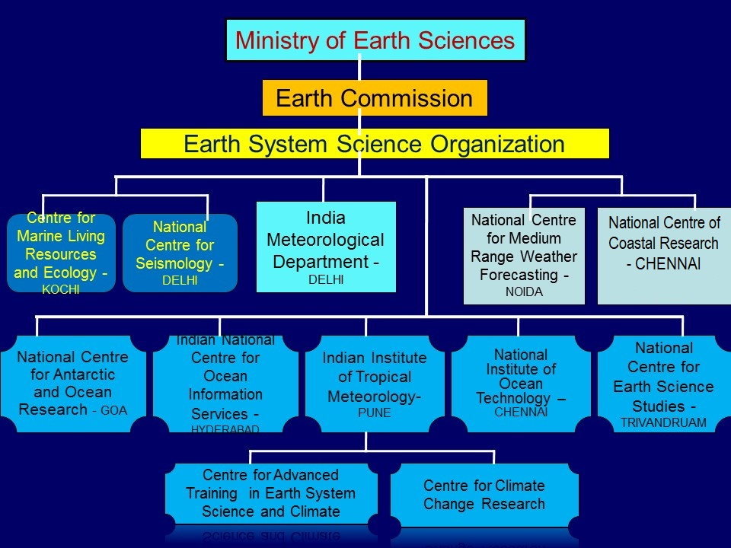

Slide 3
IMD observational Network
RS/RW obs. Stations
 | Type of Observation | No of Stations
1 | RS/RW | 42
2 | Pilot | 60
3 | Surface Observatories | ~700
4 | ARG+AWS | 573+1351
5 | AGRO met | 123
6 | Radar | 24
INSAT Processing chain, 3 HRPT stations
Details by IMD

Slide 4
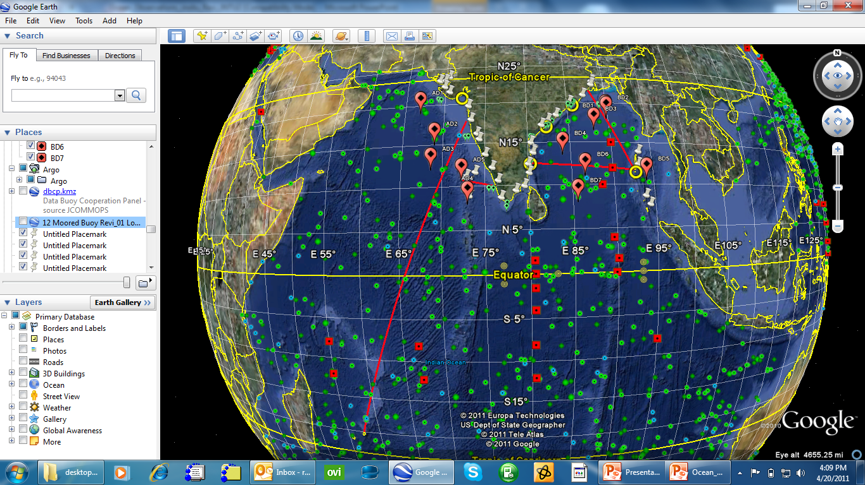
Indian Ocean Observing System
Green – Argo,
Red line – XBT,
Blue – Drifters,
Red square – RAMA,
Yellow- CODAR,
Green_oval- ADCP,
Red_oval – Moorings,
White mark - TG
847 ARGO, 30 drifters, 3 wave rider buoys, AWS, Servicing current meter moorings (ADCP & Deep), operate coastal CTD using Ships of Opportunity, 5 pairs of HF radar
Satellite Data Reception & Processing System for OCM-2 & AVHRR, HF Radar

Slide 5
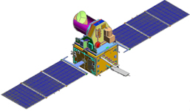
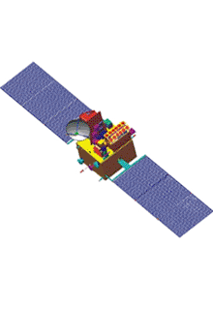
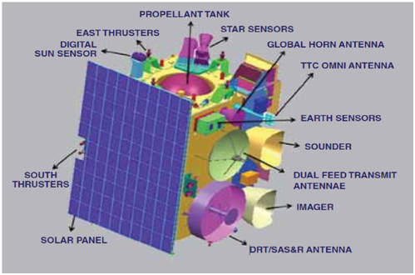
Data Reception System at NCMRWF
NOAA
(98 GB)
DWR
(32 GB)
NCMRWF
ScatSat
MeghaTropiques
SAPHIR & ROSA
SATMET
(53 GB)
GTS
(1 GB)
(0.5 GB)
ISRO
(108 GB)
EUMETCAST
NRSC
(8GB)
JMA
ISSDC
(1.3GB)
CMA
INSAT3D & 3R

Slide 6
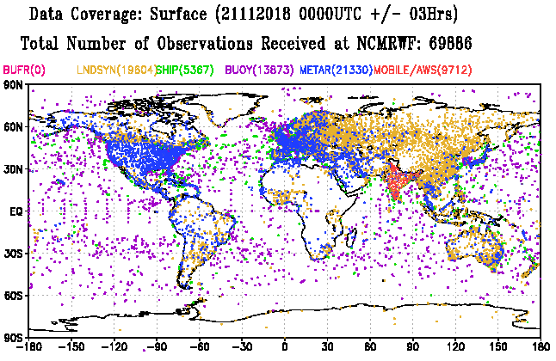
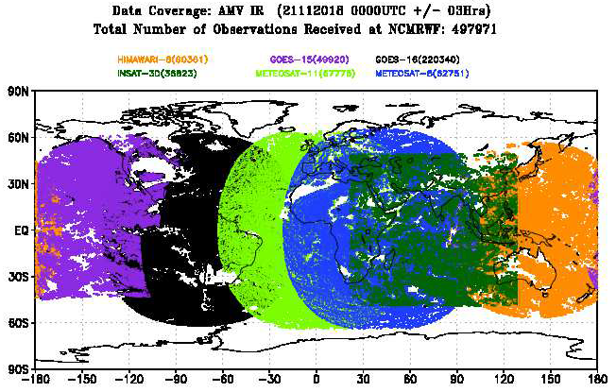
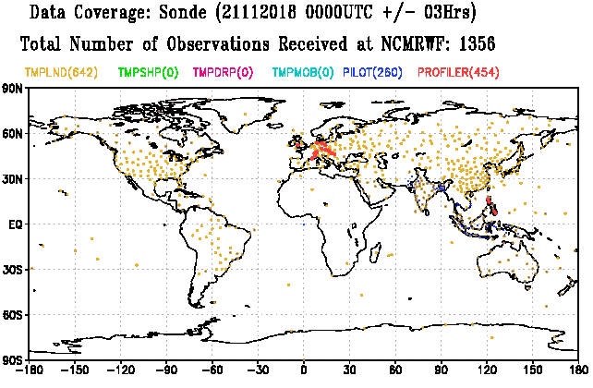
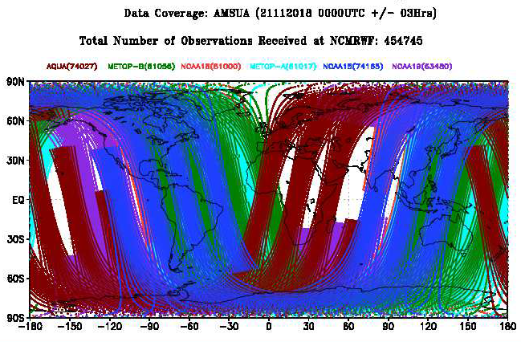
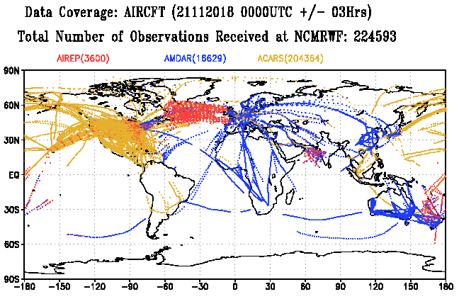
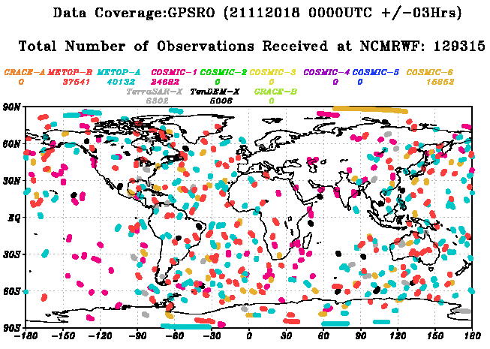
Real Time Monitoring of Observations: Quantity
Observations received (few types are presented here) within the cut-off time of a typical Data Assimilation cycle (00 UTC 21-Nov-2018)

Slide 7
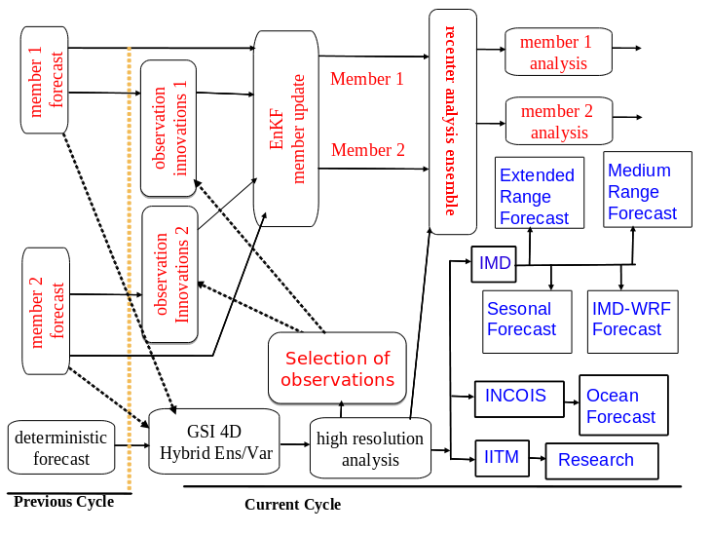
GFS based Forecasting system using 4D-Ens-VAR
Plans to increase ENKF resolution from T-574 to 1534. Generating and using NSST
Analysis instead of RTG-SST , use of new ABI,AHI, Cris (full resolution), NPOES and COSMIC-2
IMD is working retrospective forecast using NCMRWF reanalysis data for seasonal forecasting.

Slide 8
GFS DA Highlights
All four cycles (00, 06, 12 and 18 UTC) GFS DA is being carried out with
a) early run with 2 hour cut-off
b) update run with 5 hour cut-off
Each DA cycle is completed in ~30 min.
GEFS at T1534L64 forecasts are carried out every day for 00UTC
T1534L64 GFS forecasts for 10 day period are carried out at 00 and 12 UTC
For seasonal and extended range forecasts using CFS-V2 and MEM respectively.

Slide 9
Increase in availability of Indian In-situ (IMD) observations for assimilation with More frequent (5 min) decoding from 15th June 2018 (in Mihir)
Timeliness in Data Reception
% of observations received within various cut-off hours

Slide 10
Reception of RS/RW and PILOT Balloon Observations for 00UTC 26 June and 26 JULY 2018
EARLY RUN (with 2-hr Data Cut-Off)
UPDATE-CYCLE RUN (with 5-hr Data Cut-Off)
00UTC 26 June 2018
00UTC 26 July 2018
More GTS Data in 2-hr cut-off

Slide 11
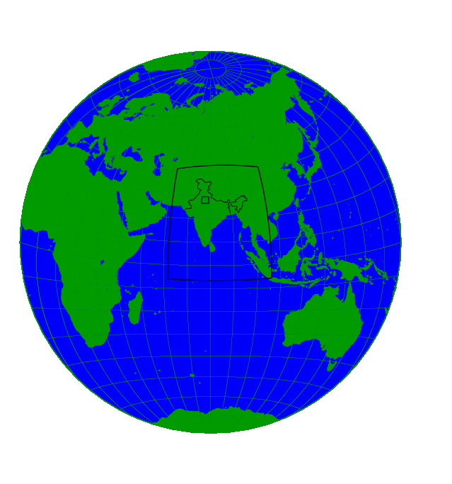
NCMRWF Unified Model (NCUM) and Data Assimilation System
NCUM Global Model (12km) with Hybrid 4D-Var Data Assimilation (Atmosphere) and Extended Kalman Filter (EKF) based Land Data Assimilation
NCUM Regional Model (4 km) with 4D-Var Data Assimilation
Sri Amarnathji Yatra model (1.5 km) (Only during Yatra period) (downscaled initial condition)
330 m Delhi fog model based on NCUM (Only during winter) (downscaled initial condition)
NCMRWF Global Ensemble Prediction System (NEPS) (12 km / 22 +1 members) with Ensemble Transform Kalman Filter (ETKF) for Initial condition perturbations
Regional NEPS (4 km /11+1 member) (only during specific events) (downscaled initial conditions from global NEPS)
Coupled Model with Data Assimilation for Atmosphere (Hybrid 4D-Var), Ocean (3D-Var),Sea Ice (3D -Var) and Land (EKF)
330 m Delhi Fog Model (36 hrs forecast based on 00 UTC)
1.5 km Regional Model (48 hrs forecast based on 00 UTC)
4 km Regional Model
(72 hrs forecast based on 00 UTC)
12 km Global Model
(10 Day forecast based on 00 & 12 UTC)
Global Ensemble Prediction System (NEPS) –
12 km23 members (10 Days forecast from 00 UTC)
Regional NEPS
(4 km / 12 members, 72 hrs forecast based on 00 UTC)
Coupled Model (60 km)
(NCUM+JULES+NEMO+CICE)
(One Month )

Slide 12
Observations Assimilated at NCMRWF System
Conventional Observations | Satellite Observations
 | Satellite Winds |  | Scatterometer winds | Satellite Radiances |  |  | GPS-RO
 | Geostationary | Low Earth Orbit | Low Earth Orbit | Geostationary | Low Earth Orbit (LEO) |  | Low Earth Orbit
 |  |  |  | Infra Red (IR) Channels | IR (Hyperspectral) | MicroWave (MW) Channels | Bending Angle
Surface: Land SYNOP, METAR, AWS, Ship, BUOY, BOGUS SONDE: PILOT, TEMP, WindProfiler, DropSonde, Radar VAD winds Aircraft: AMDAR, AIREP | 1. INSAT-3D (ISRO) | 1.NOAA-15 | 1.ASCAT (MetOp-A) | 1.INSAT-3D Sounder | 1.IASI (MetOp-A) | 1.AMSU-A (MetOp-A) | 1. COSMIC
 | 2.Meteosat-8 | 2.NOAA-18 | 2.ASCAT (MetOp-B) | 2.SEVIRI (Meteosat-8) | 2.IASI (MetOp-B) | 2. AMSU-A (MetOp-B) | 2.GRAS (MetOp-A)
 | 3.Meteosat-11 | 3. NOAA-19 | 3. Scatsat (ISRO) | 3.SEVIRI (Meteosat-11) | 3.AIRS (AQUA) | 3. AMSU-A (NOAA-18) | 3. GRAS (MetOp-B)
 | 4.GOES-15 | 4.MetOp-A | 4. Windsat (Coriolis) | 4.GOES Imager (GOES-15) | 4.CrIS (SNPP) | 4. AMSU-A (NOAA-19) | 4. ROSA (MT)
 | 5.HIMAWARI-8 | 5.MetOp-B |  | 5.AHI (HIMAWARI-8) |  | 5. AMSU-A (NOAA-15) | 5. TanDEM-X
 | 6.GOES-16 | 6. AQUA |  | 6.INSAT-3D Imager |  | 5.AMSU-B (MetOp-A) | 6. TerraSAR-X
 |  | 7. TERRA |  |  |  | 6. AMSU-B (MetOp-B) | 7. FY-3C
 |  | 8. SNPP |  |  |  | 7. AMSU-B (NOAA-18)
 |  |  |  |  |  | 8. AMSU-B (NOAA-19)
 |  |  |  |  |  | 10. SAPHIR (MT)
 |  |  |  |  |  | 11.ATMS (SNPP)
 |  |  |  |  |  | 12.SSMIS (DMSP-F17)
 |  |  |  |  |  | 13. AMSR (GCOM-W1)
 |  |  |  |  |  | 14.MWHS (FY3C)
 |  |  |  |  |  | 15. GMI (GPM)
Recently added observation types/instruments

Slide 13
Ocean Models at INCOIS
Ocean Models
Scenario database of 50,000 scenarios
HOOFS
HYCOM
INCOIS-GODAS
MOM
Tsunami
Storm Surge

Slide 14
Future
Assimilation of ABI, AHI and Cosmic-2 etc
DBNet data assimilation (ASCAT, CRIS etc)
Special emphasis to Indian Satellite data sets
Aeolus ADM
Duel Metop(A&B) AMV’s
TAC to BUFR : Upper-Air, Buoy, SYNOP and Ship
Moving to Coupled Data Assimilation

Slide 15
THANKS

